Slide 1
Optimized Retrieval and Query Processing: A Synergistic Approach for Improved DAtabase perfomace
Saptarshi Acharya 22BCE1134
Rishabh Shital Ramdhave 22BCE1824
Abhishek Kumar Singh 22BCE1867

Slide 2
introduction
Problem with Traditional Systems:
Traditional DBMS face challenges in handling large datasets efficiently, with issues like scalability and slow query performance due to reliance on basic techniques like Boolean retrieval and simple indexing.
Proposed Solution:
This paper introduces a novel approach that combines Caching Techniques (Splay Trees and Randomized Search Trees) with Cost-Based Query Optimization (CBO) to improve both data retrieval and query processing.
Caching with Splay Trees and RSTs:
Splay Trees and RSTs could be used optimize data retrieval by maintaining dynamic and efficient access paths, reducing retrieval time and improving cache performance.
Impact on Performance:
By integrating Caching and Cost-Based Optimization, the proposed method reduces query latency, enhances retrieval speed, and improves system scalability, addressing the performance bottlenecks in traditional systems.

Slide 3
introduction
Potential Implementation in Indian Railways:
The proposed approach could be applied to improve the performance of the Indian Railway's Reservation and Ticketing System (IRCTC), which currently suffers from slow query processing. By implementing these optimization techniques, query response times can be significantly reduced, enhancing user experience and system efficiency.

Slide 4
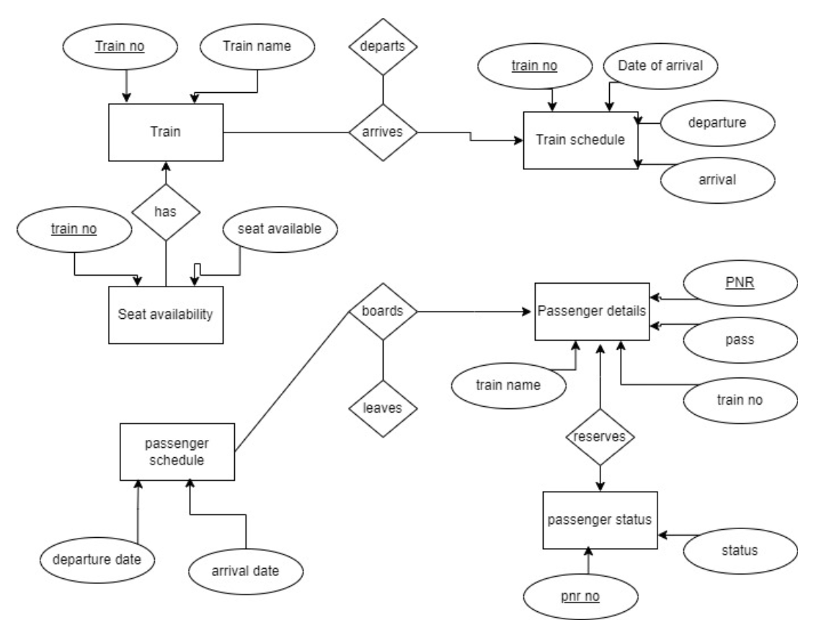
ER Diagram

Slide 5
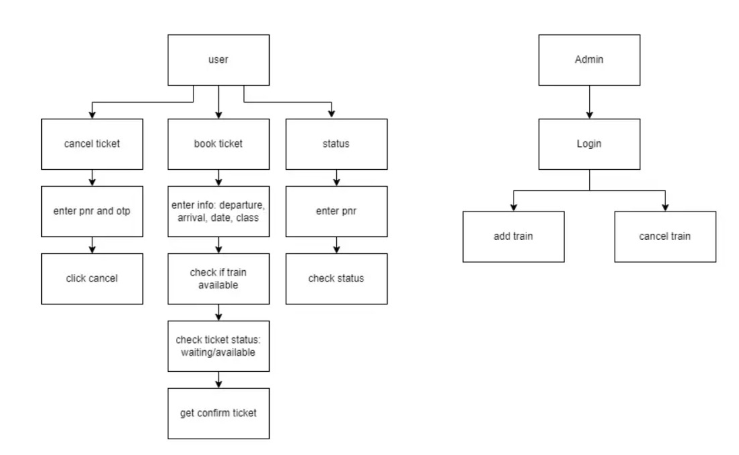
Functional diagram (high level diagram)

Slide 6
Conventional Strategies and Techniques
Boolean Retrieval:
Boolean retrieval uses logical operators (AND, OR, NOT) to filter and retrieve documents matching specific conditions. This approach is straightforward and computationally inexpensive, commonly used for exact matches.
Demerit: It lacks the ability to rank documents by relevance, leading to either an overwhelming number of results or excluding potentially relevant information in complex queries, thus limiting accuracy.
Vector Space Model (VSM):
VSM represents both queries and documents as vectors in a high-dimensional space, where the relevance of each document is calculated based on cosine similarity between vectors. This approach enables ranked retrieval of results by similarity scores.
Demerit: It is computationally expensive for large datasets due to high-dimensional vector calculations and lacks semantic understanding, making it difficult to capture the deeper meaning of complex or ambiguous queries.

Slide 7
Conventional Strategies and Techniques
B-tree Indexing:
B-tree indexing organizes data hierarchically, allowing for efficient search and retrieval, especially for range queries. B-trees are widely used due to their balanced structure, which maintains query efficiency across different data sizes.
Demerit: With frequent insertions, deletions, and updates, B-trees can require frequent rebalancing, increasing maintenance overhead. Additionally, large datasets can cause B-trees to become deep, resulting in slower searches as more nodes are traversed.
Materialized Views:
Materialized views store precomputed query results, which can then be quickly retrieved without recalculating. This approach is effective for complex queries or reporting, as it reduces the computational cost for repeated queries on static datasets.
Demerit: Materialized views require substantial storage and constant maintenance to stay synchronized with underlying data. In dynamic datasets, updating views frequently can add significant overhead, potentially offsetting the performance gains from caching results.

